Slide 1
The International Integrated Reporting Framework
Ben Koo
benkoo@tsinghua.edu.cn
March 17th，2020
Notes:
今天的主题是“区块链启发的新产业范式”

Slide 2
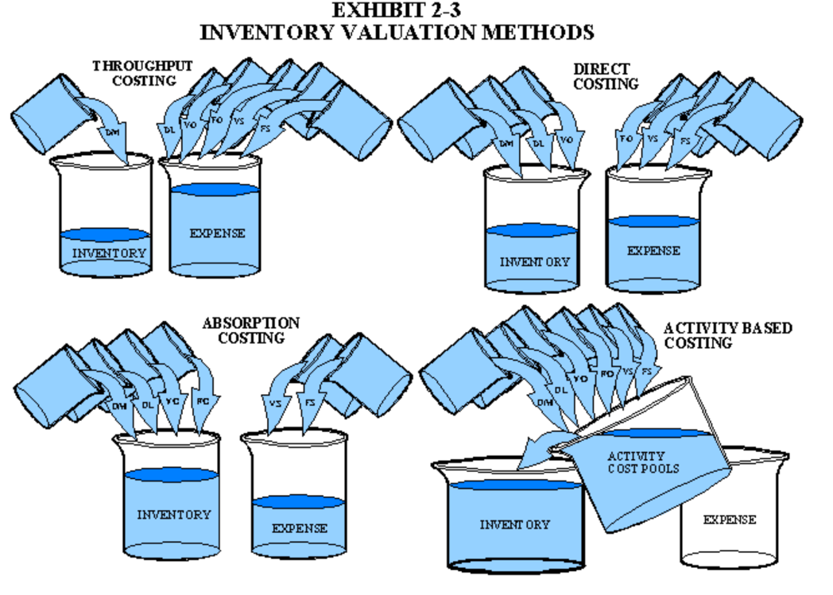
Review: Accounting Practices shapes governance at a Global Scale
Image source: https://maaw.info/Chapter2.htm

Slide 3
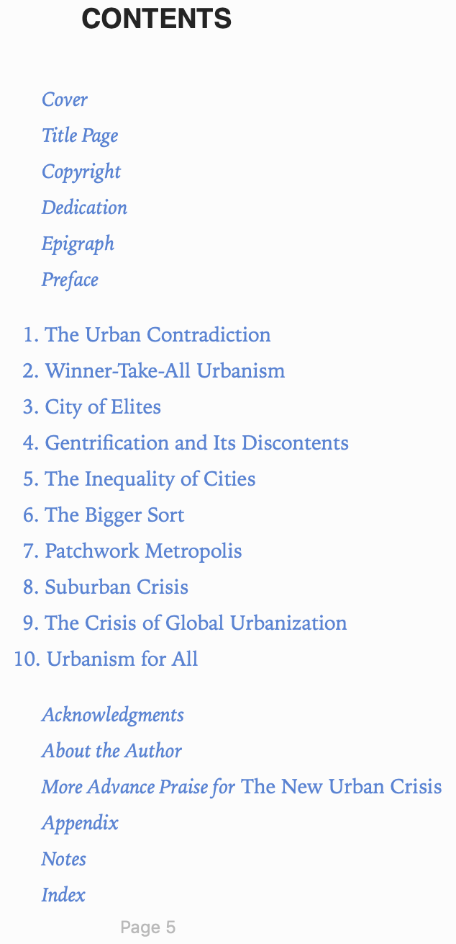

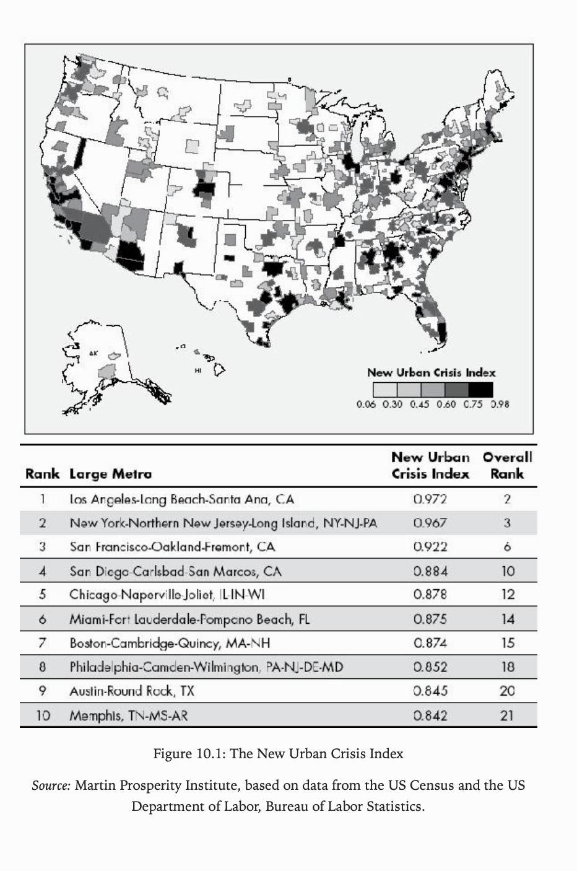
The book on The New Urban Crisis
Page. 197

Slide 4
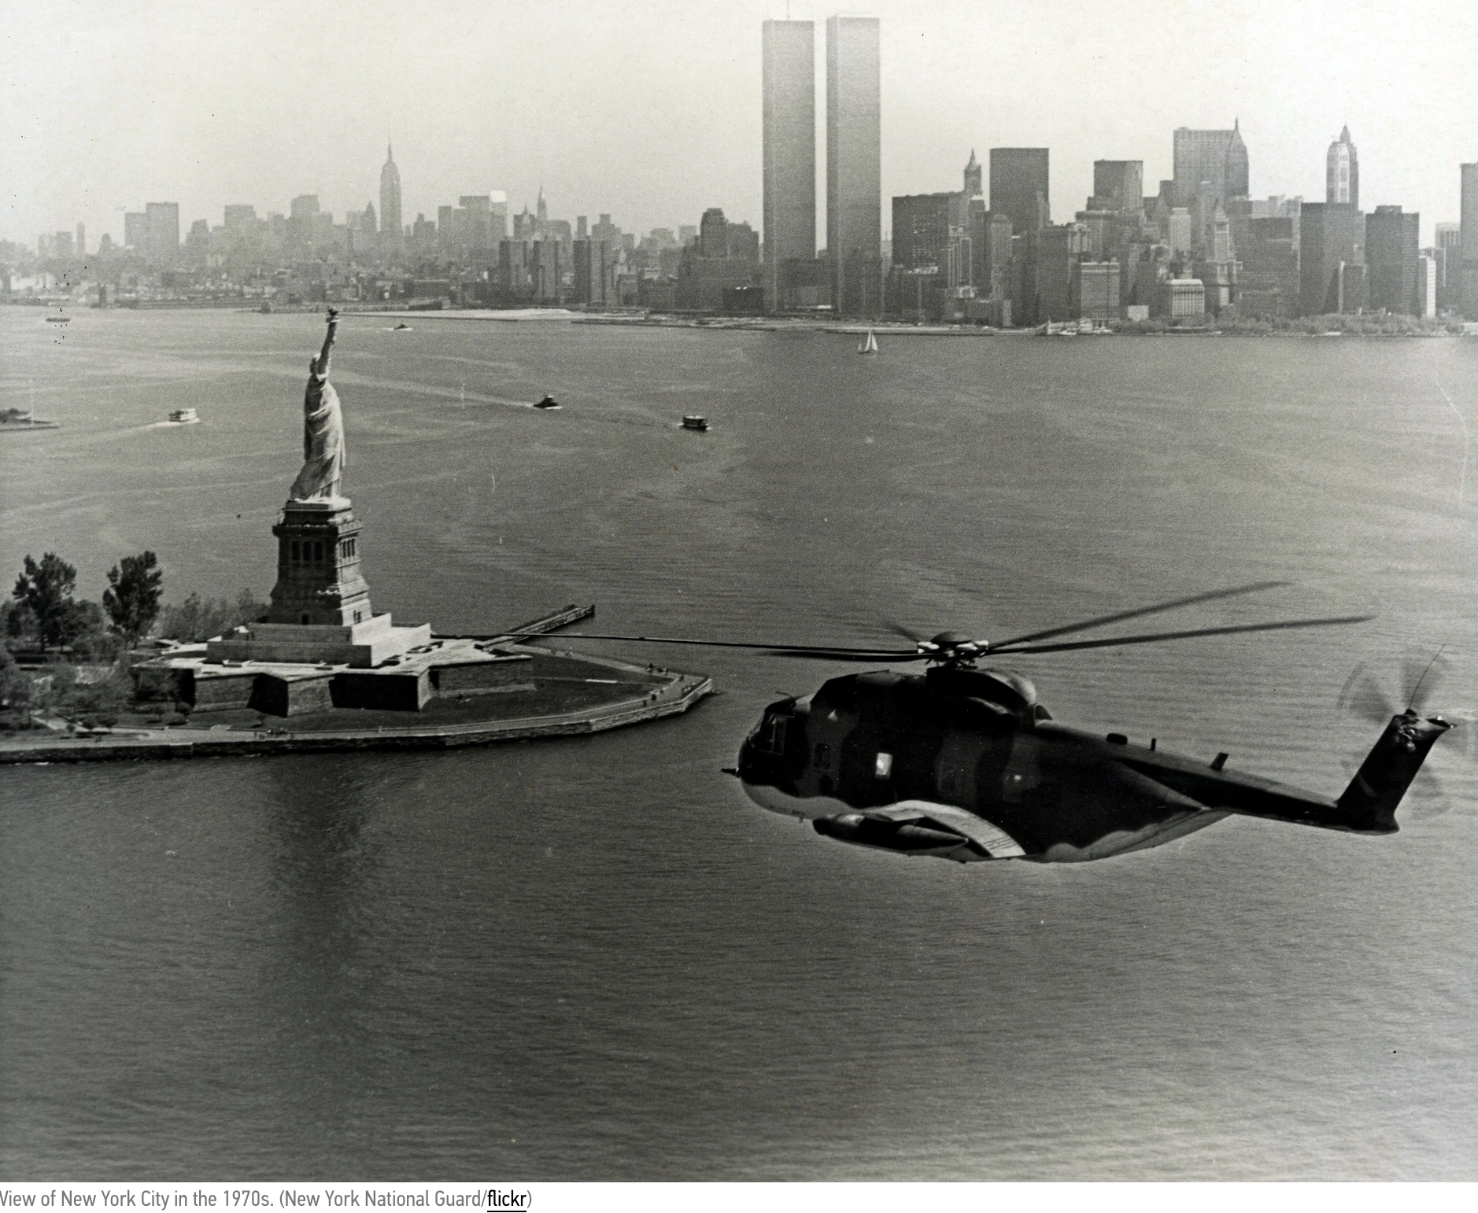
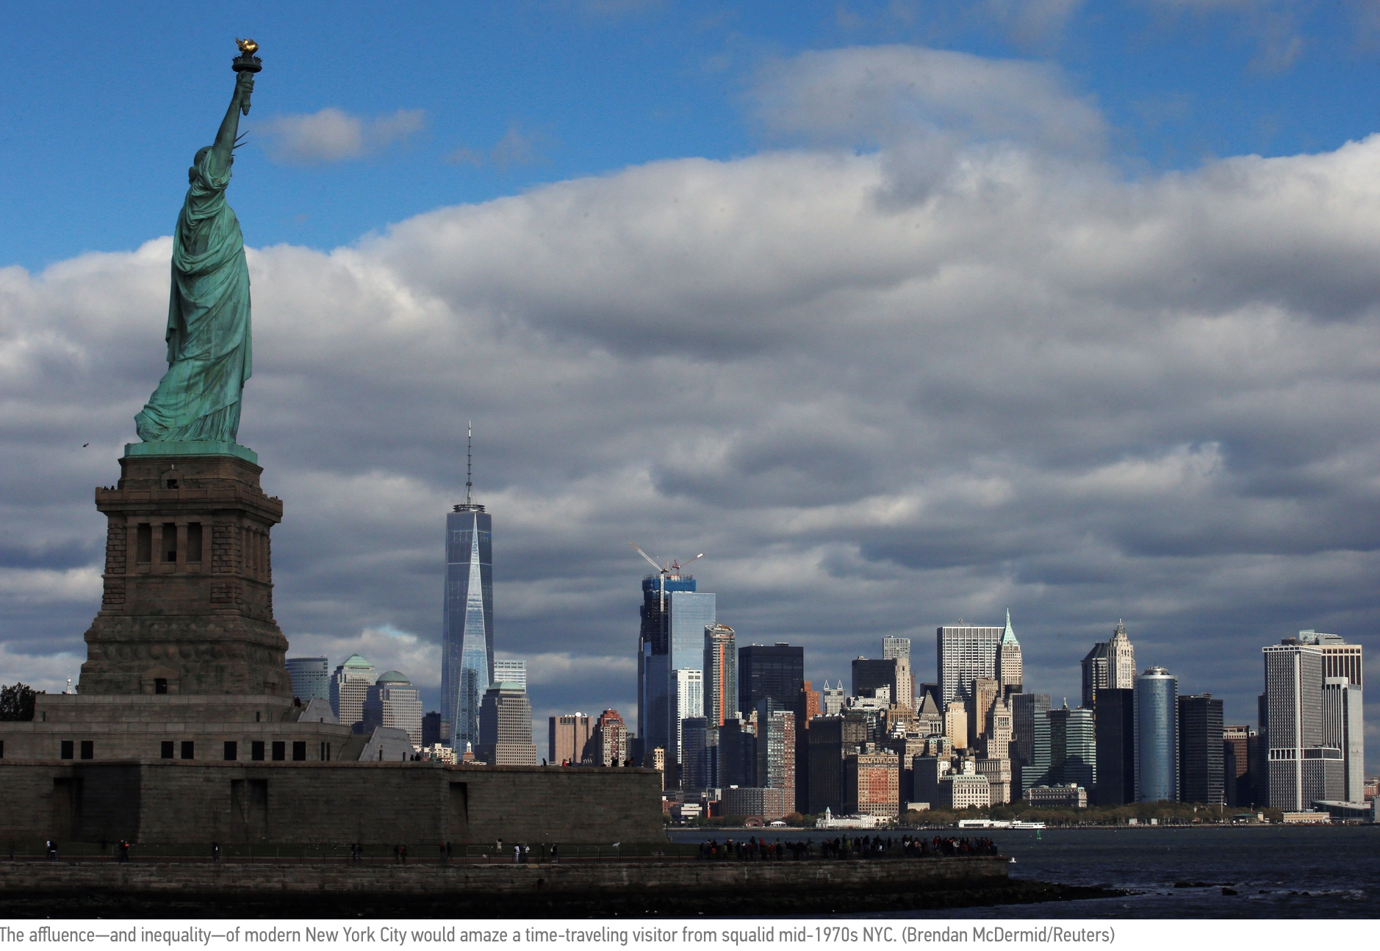
The Article on the New Urban Crisis
https://www.citylab.com/equity/2017/04/confronting-the-new-urban-crisis/521031/

Slide 5
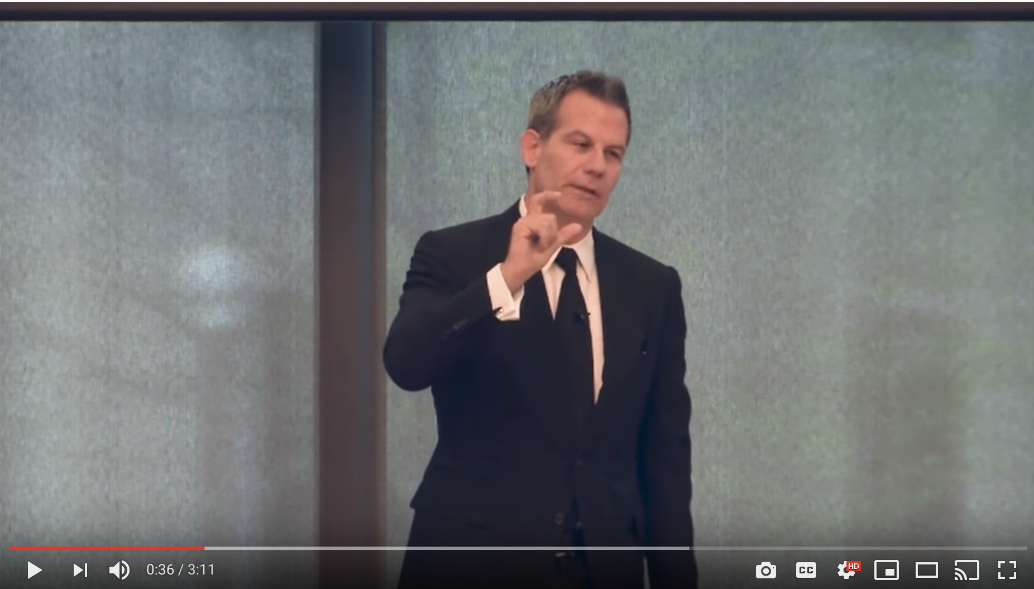
Richard Florida @ Rotman School
https://youtu.be/WKYw7rgBMjw

Slide 6
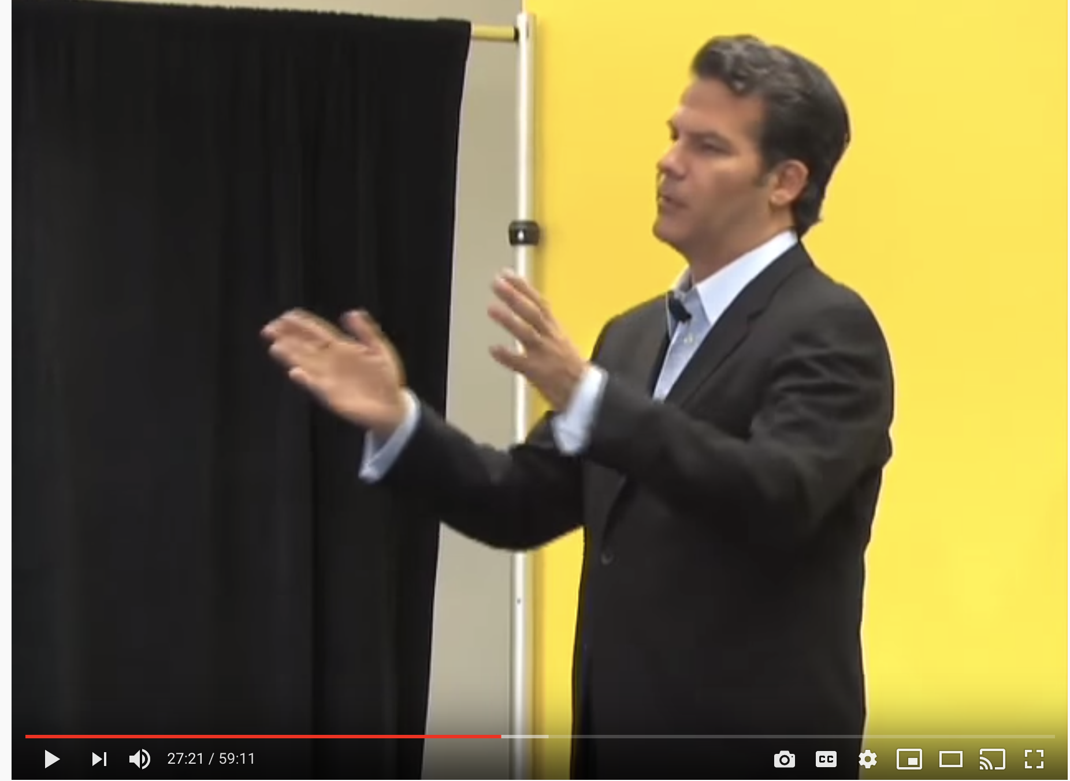
"Who's Your City?" | Talks at Google
https://youtu.be/Cj1OpiBRNsg

Slide 7

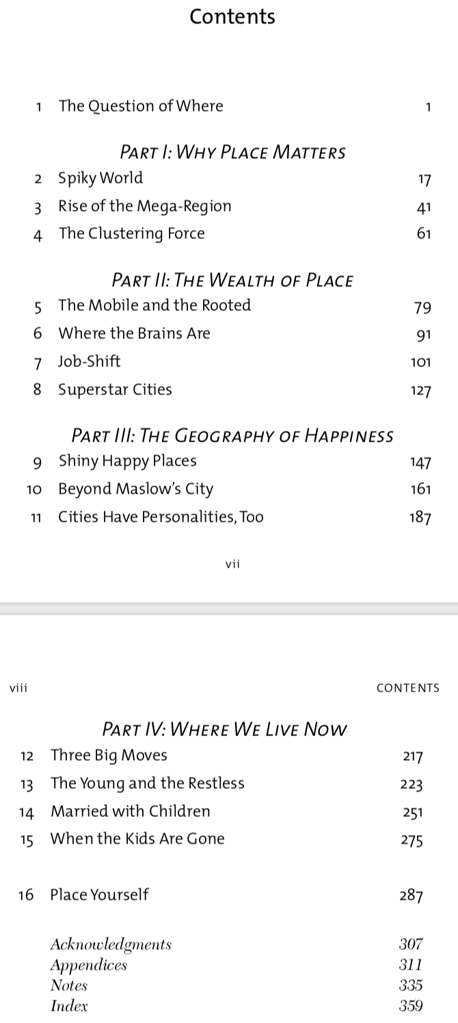
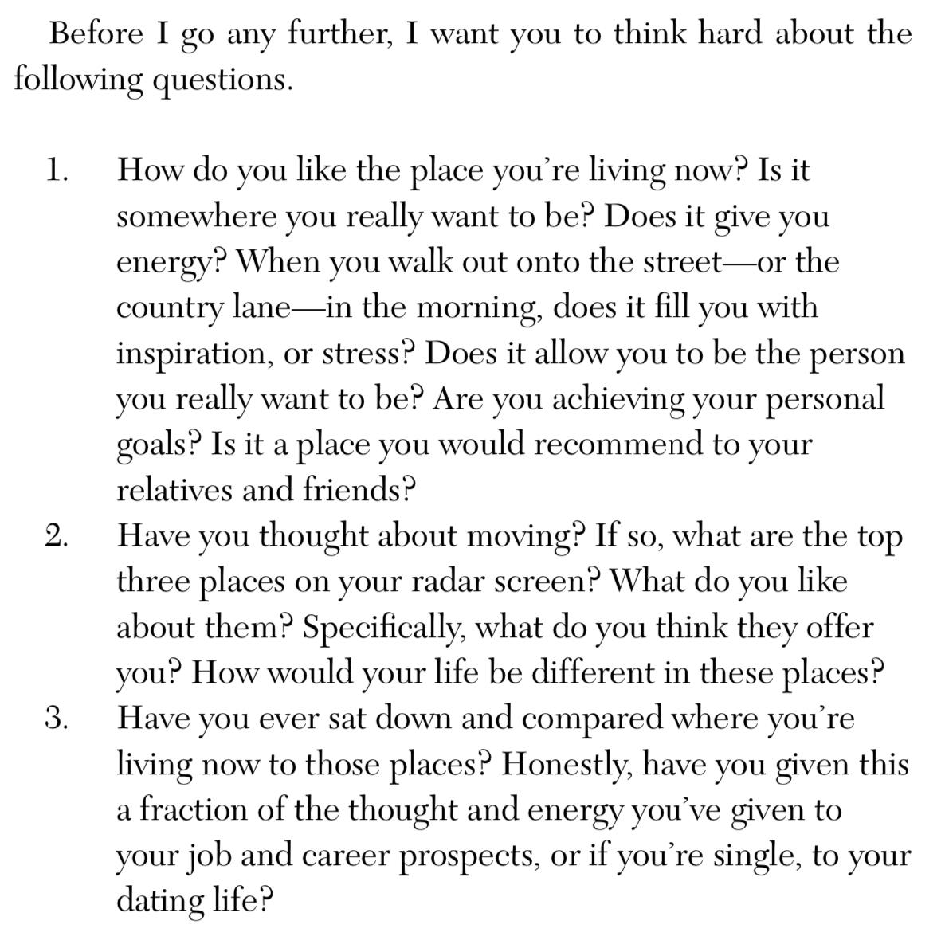
Who's Your City? The most important decision of your life.

Slide 8

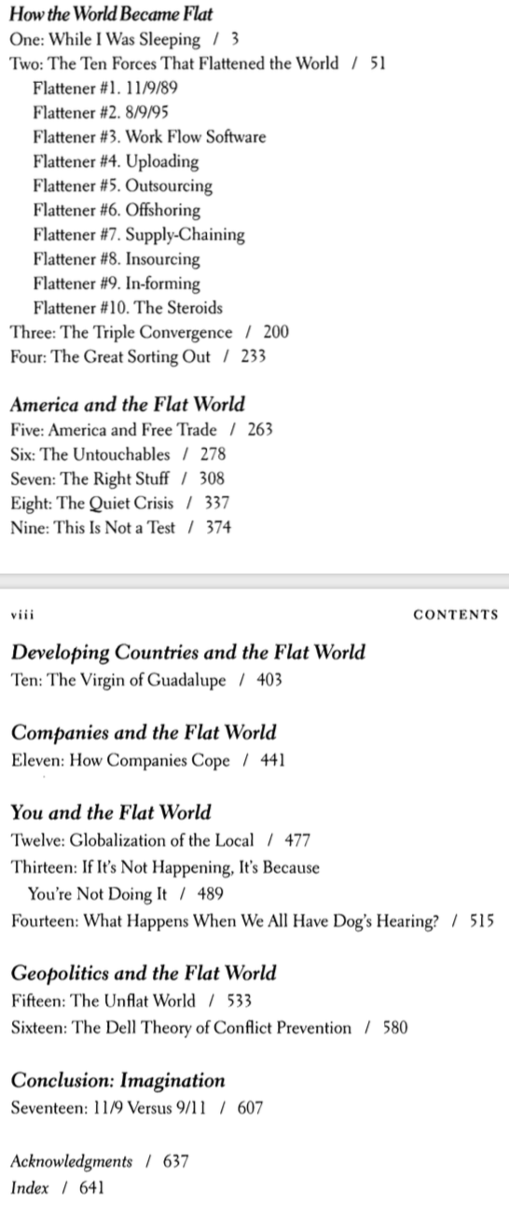
The World is Flat?

Slide 9
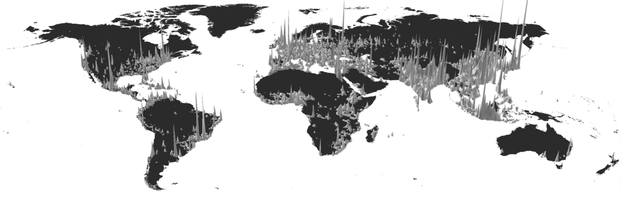
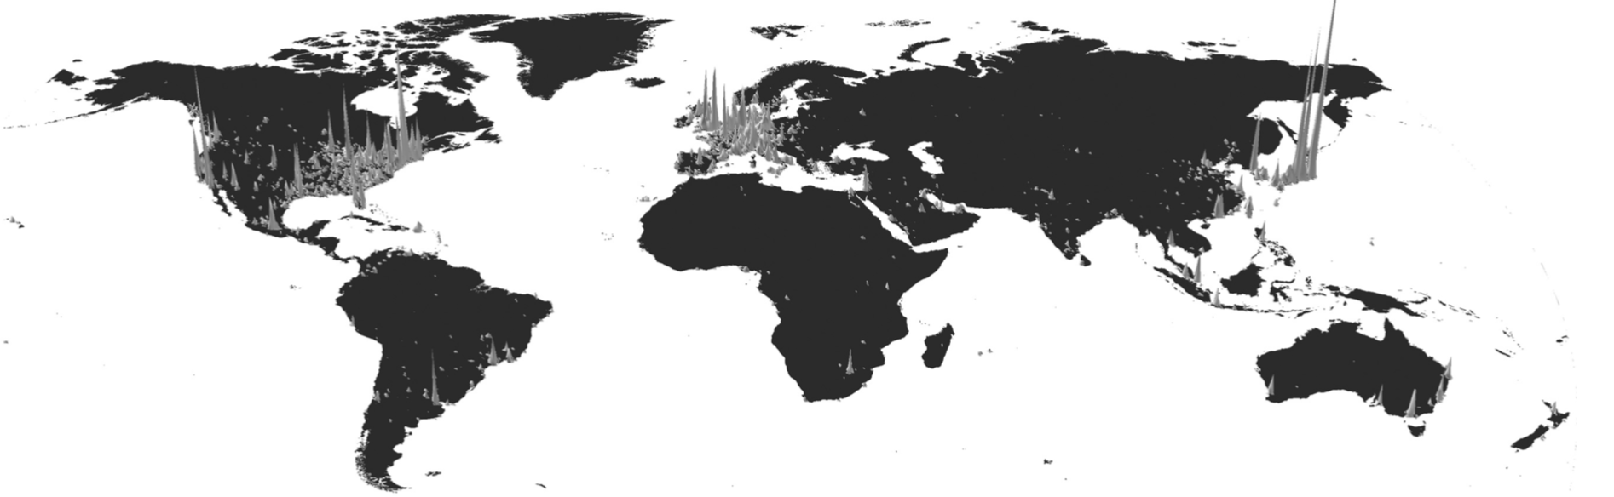

The Spiky World
Population
Economy
Innovation

Slide 10
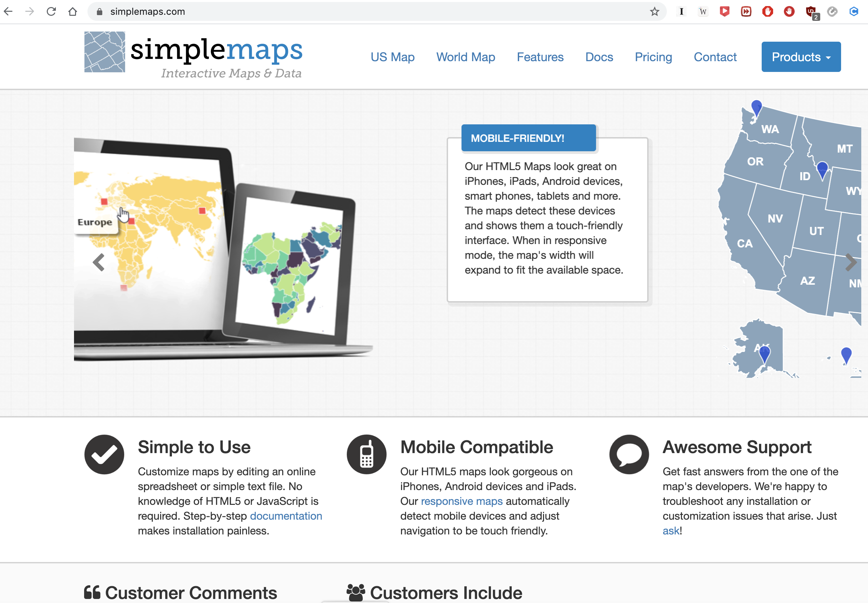
A tool that help you create maps
http://simplemaps.com

Slide 11
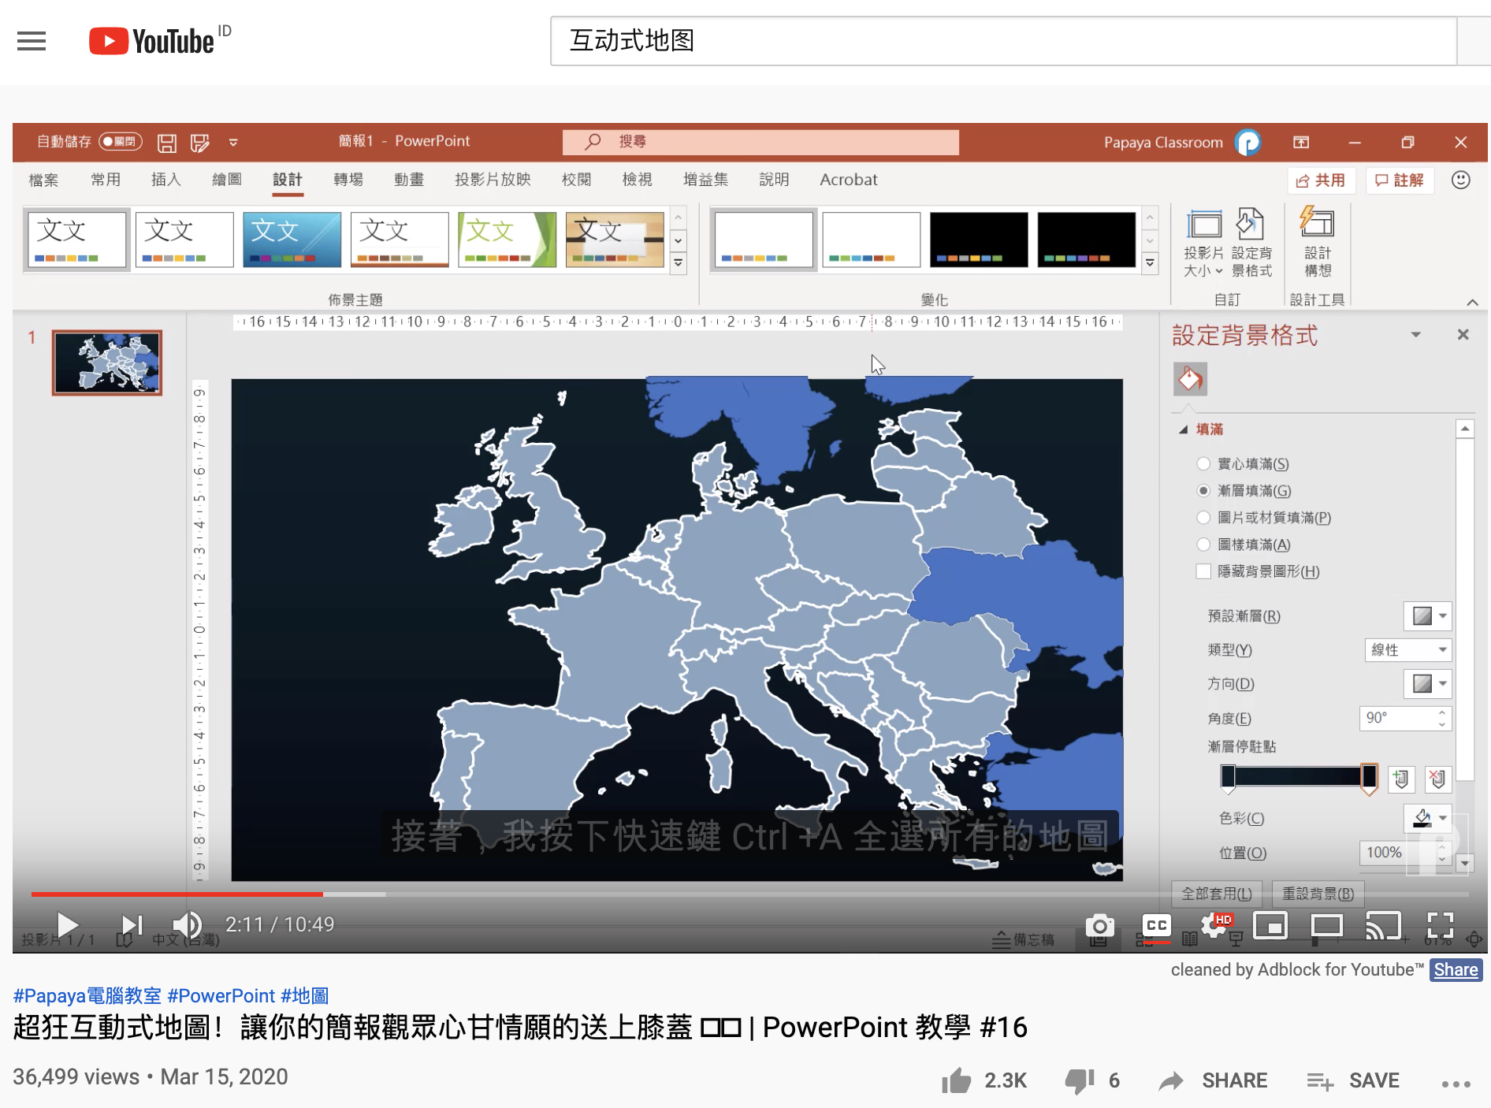
How to create Interactive Maps?
https://youtu.be/o01iHIT9Tyk

Slide 12

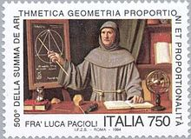
Double Entry Accounting ignited Capitalism
1494 1st Ed.，1523 2nd Ed.
Pacioli was primarily remembered by Double Entry Book Keeping
Pacioli worked with da Vinci to create paintings and sculptures
Summa de arithmetica, geometria, proportioni et proportionalita （算术、几何、比与比例概要）
“historian James Aho linked double-entry bookkeeping to the ancient art of rhetoric, … medieval merchants used double-entry bookkeeping as a rhetorical tool of capitalist propaganda, to persuade their ‘audience’ that their business was honest, morally sound and its profit-making ethically justified.”
Excerpt From: Jane Gleeson-White. “Double Entry.”
Notes:
“historian James Aho linked double-entry bookkeeping to the ancient art of rhetoric,”
Excerpt From: Jane Gleeson-White. “Double Entry.” Apple Books.

Slide 13
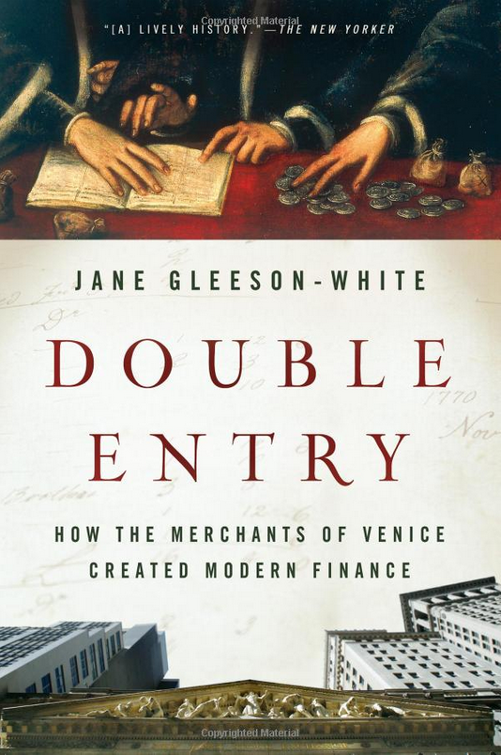



复式记账 ：僧人，数学与魔法
https://youtu.be/jmVfDbqRxKo

Slide 14
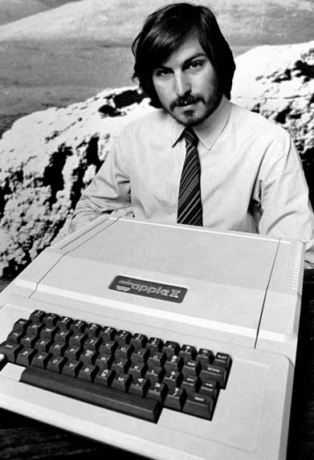
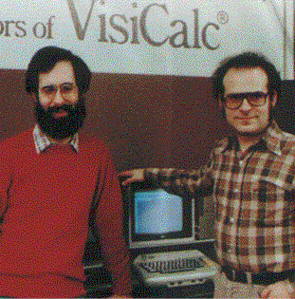
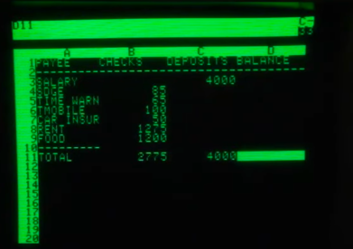
The Magic of Accountants
A brief history of Spreadsheet
http://www.dssresources.com/history/sshistory.html
Software Arts Corporation
Formed on January 2, 1979
https://en.wikipedia.org/wiki/Moore%27s_law
Image source: https://maaw.info/Chapter2.htm
Notes:
活性，安全性，效率

Slide 15
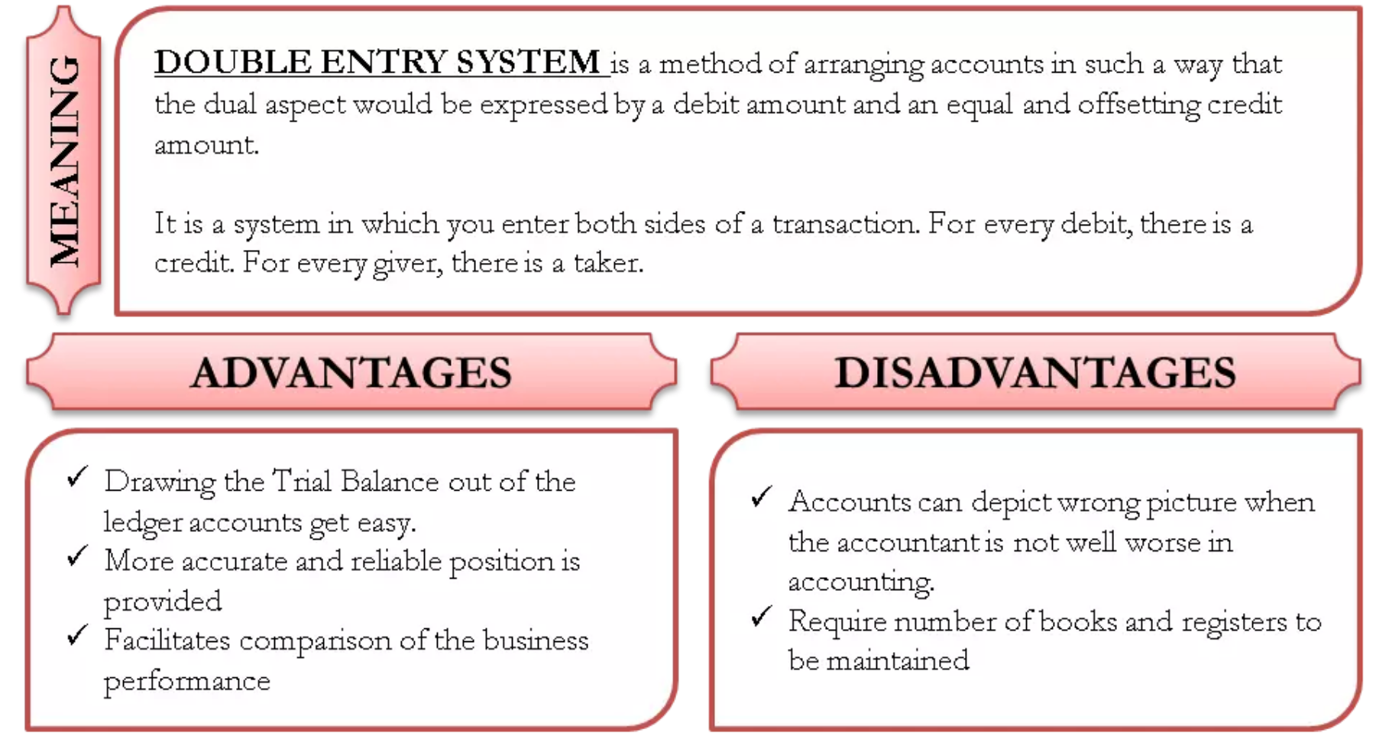
The Double Entry System
Image Source: https://efinancemanagement.com/financial-accounting/double-entry-system-of-bookkeeping

Slide 16
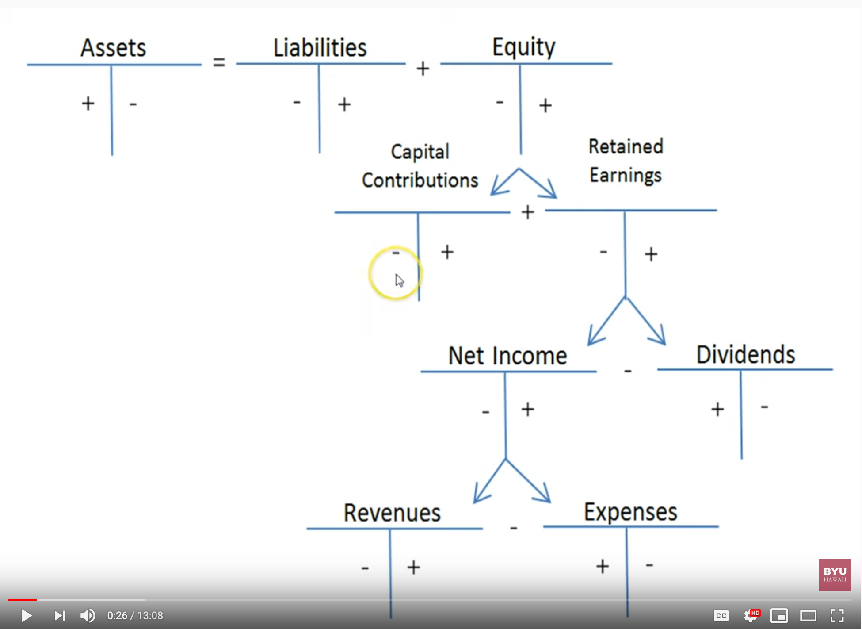
Debits and Credits and the Expanded Accounting Equation
Image source: https://youtu.be/gIWmPrUDj_M

Slide 17
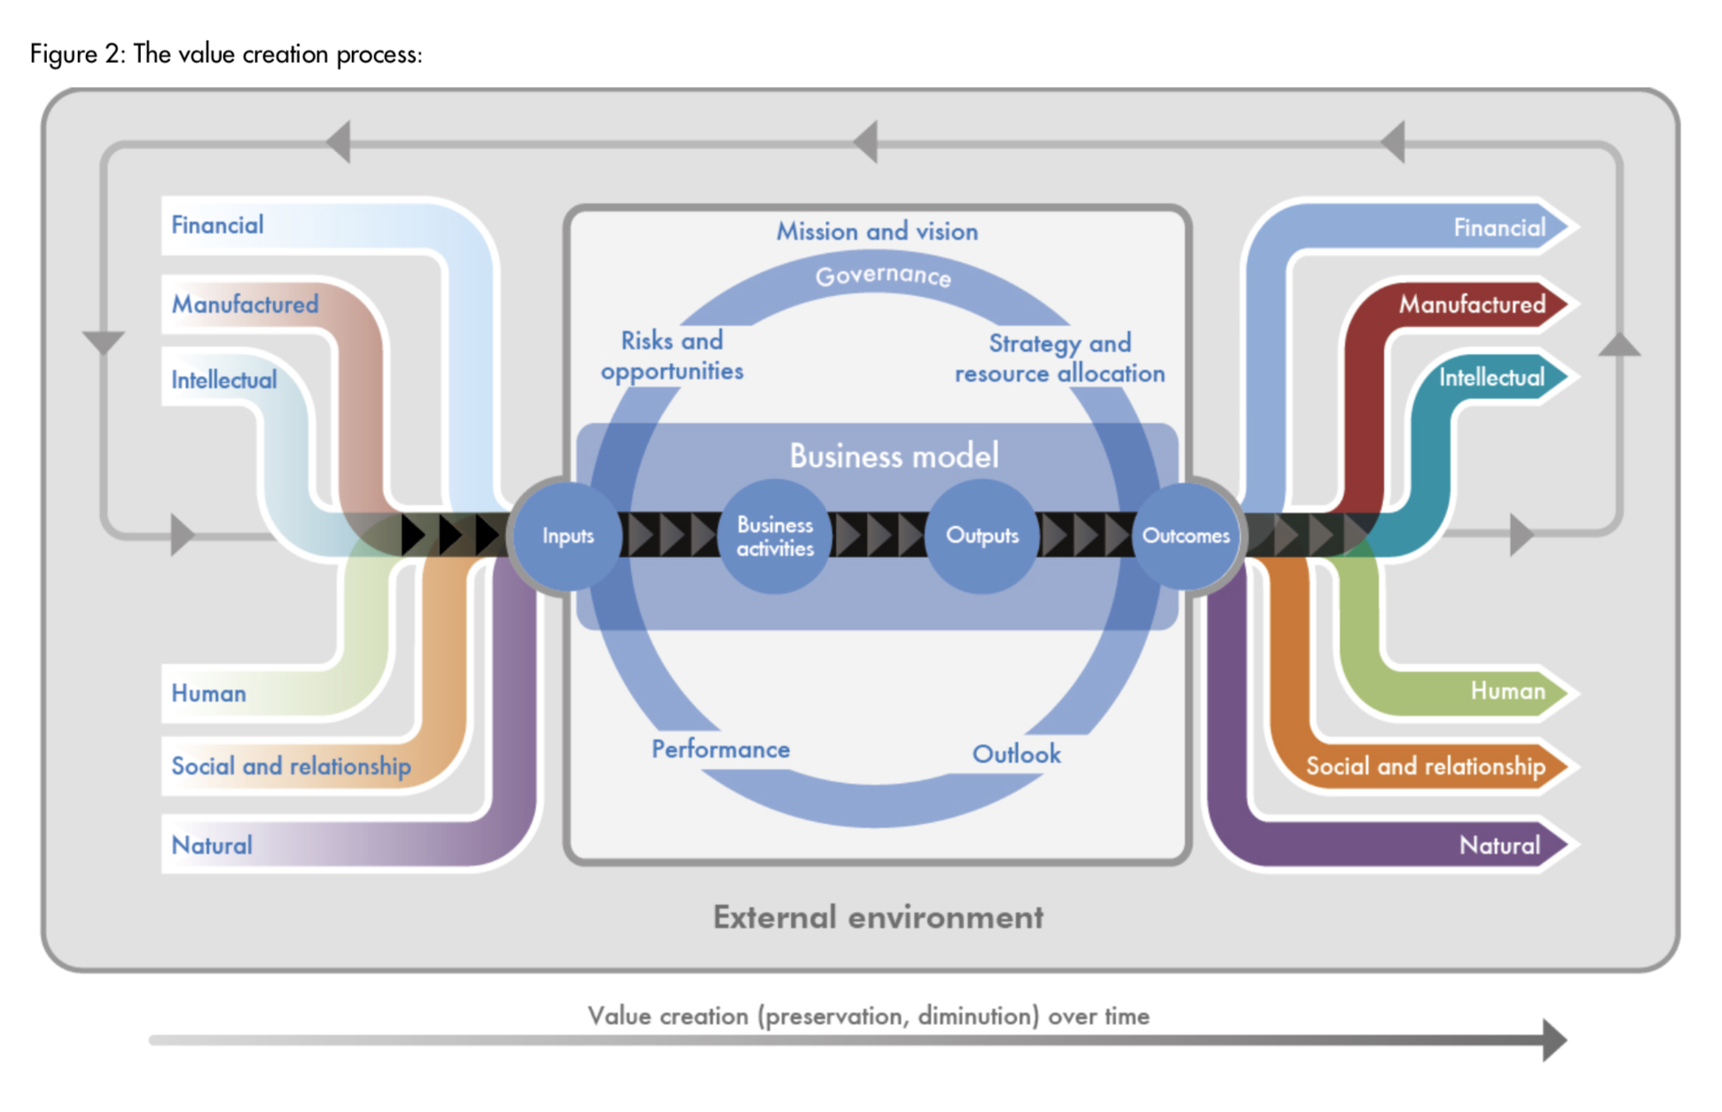

Accountants’ Value Proposition
The International
Integrated Reporting
Framework
Dec. 2013
Notes:
“historian James Aho linked double-entry bookkeeping to the ancient art of rhetoric,”
Excerpt From: Jane Gleeson-White. “Double Entry.” Apple Books.

Slide 18
Context: Describe the Spatial and Temporal boundaries of the project.
Abstract Specification
Goal: Mission Statement written in an imperative sentence with reference to “Context”.
Measurable Effects: Conditional statements of the observable implementation outcomes that satisfy the “Goal”.
Concrete Implementation Process
Inputs
Prescribe the required resources to be consumed in the implementation Process
Activities
A structured set of actions that depicts implementation activities.
Ideally written in a formalized process specification language
Outputs
A list of noun phrases that declares the deliverable items from proposed activities
Boundary Conditions: When and how the boundaries of the previously defined ”Context” could be broken?

